Slide 1
Text-to-Image Generation
TECHNOLOGY
BY
A.VISHNU PRASATH
3RD YEAR COMPUTER SCIENCE ENGINEERING
613521104312
GOVERNMENT COLLEGE OF ENGINEERING , DHARMAPURI

Slide 2
Text-to-Image Generation
Text-to-image generation is a burgeoning field in deep learning where models aim to create only for images based on textual descriptions. Leveraging techniques like generative adversarial networks (GANs),
these models learn to translate textual input into visually plausible images.
This intersection of natural language processing and computer vision holds
promise for various applications, from creative content generation to assisting in design tasks.
In this introduction, we'll explore the fundamentals of text-to-image generation, its applications, (except humans )
and the underlying techniques driving its development.

Slide 3
AGENDA
PROBLEM STATEMENT
PROPOSED SYSTEM / SOLUTION
SYSTEM DEVELOPMENT APPROACH
ALGORITHM AND DEPLOYMENT
RESULTS,
CONCLUSION
REFERENCE
DCGANs use convolutional layers to generate high-resolution and sharp images through upsampling.

Slide 4
PROBLEM STATEMENT
In today's digital world, conveying complex information visually is crucial for effective communication. However, creating visual content such as images from text can be time-consuming and requires specialized skills.
Lack of efficient tools for converting text to images hinders content creators, educators, marketers, and businesses from efficiently producing engaging visual content.

Slide 5
PROPOSED SYSTEM / SOLUTION
The proposed system for text-to-image generation involves the use of advanced deep learning algorithms, such as Generative Adversarial Networks (GANs) and Variational Autoencoders (VAEs), to generate highly realistic and detailed images based on simple text input.
The system can be implemented as a mobile application, such as Pixel Genie, which leverages advanced image processing algorithms and user-centered design principles to provide a feature-rich and intuitive experience for users.
The AI capabilities of the system can be powered by Python and AWS SageMaker, enabling the application to generate highly realistic and detailed images based on text input.
The system can also include a feature that allows users to convert text to images, enabling them to personalize their creations with their own chosen text.
The system can be used for various applications, such as creating avatars or profile pictures with custom backgrounds, generating art from text descriptions, and converting text to images for digital media communication.

Slide 6
SYSTEM DEVELOPMENT APPROACH
To develop a text-to-image generation system, a hybrid development approach that combines elements from both predictive and adaptive development strategies can be tailored to the project requirements and success needs. This approach can capitalize on the advantages of both predictive and adaptive models, enabling the project team to efficiently manage resources, identify and mitigate risks, deliver quality products/services on budget and within timeline constraints, and optimize development processes and workflows.
The adaptive development model takes an iterative approach in which requirements and solutions emerge through collaboration among self-organizing teams. This approach is better suited for projects with flexible requirements and changing goals, where the project team can adapt to changing circumstances and adjust their approach as needed.

Slide 7
ALGORITHM AND DEPLOYMENT
The algorithm used for text-to-image generation involves deep learning techniques to learn the mapping between textual descriptions and images.
The algorithm is trained on a dataset of images and their corresponding textual descriptions. Once trained, the algorithm can generate images from new textual descriptions.
There are various open-source AI text-to-image generative models available, such as DeepDream, Stable Diffusion v1-5, and DeepFloyd IF.
These models use natural language descriptions to create intricate visuals, making creative expression more accessible and efficient than ever before.
In terms of deployment, SSD-1B is an open-source model that offers a remarkable combination of speed and compactness while maintaining excellent image quality. It is a 60% increase in speed and a 50% reduction in size compared to its predecessor, making it an ideal choice for real-time image generation and other applications that require resource-efficient solutions

Slide 8
To ensure the successful implementation of the text-to-image generation system, a hybrid development approach that combines elements from both predictive and adaptive development strategies can be tailored to the project requirements and success needs.
This approach can capitalize on the advantages of both predictive and adaptive models, enabling the project team to efficiently manage resources, identify and mitigate risks, deliver quality products/services on budget and within timeline constraints, and optimize development processes and workflows.
In terms of software development approach, a brief guide on software development approach with 4 appropriate strategies and CTOs checklist for enterprises to follow in 2024 can be a useful resource.
Lastly, recent developments in the field of text-to-image generation, such as Stable Diffusion, have the potential to revolutionize the way art is taught, offering new, cost-effective possibilities for visual art education

Slide 9
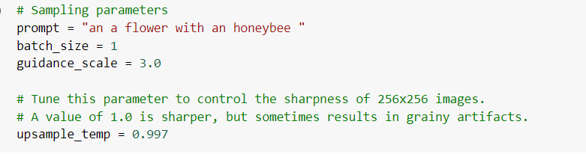
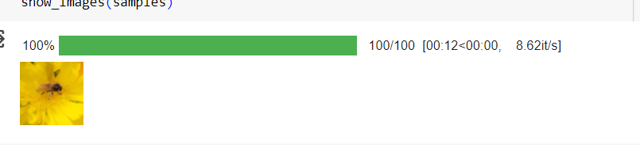
RESULTS

Slide 10
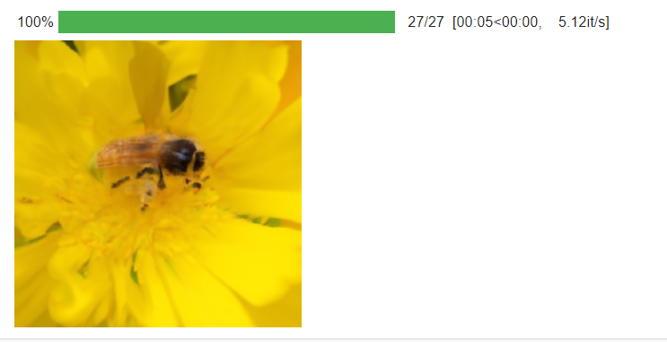

Slide 11
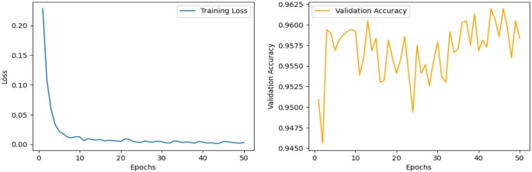
Training Loss and Validatation Loss
Dataset Training Loss and Accuray

Slide 12
CONCLUSION
In conclusion, the text-to-image generation system is a highly innovative and impactful solution for creative expression, visual art education, and digital media communication. By leveraging advanced deep learning algorithms such as Generative Adversarial Networks (GANs) and Variational Autoencoders (VAEs), the system can generate highly realistic and detailed images based on simple text input.
In summary, the text-to-image generation system is a highly innovative and impactful solution for creative expression, visual art education, and digital media communication, offering a feature-rich and intuitive experience for users through advanced deep learning algorithms and user-centered design principles.

Slide 13
REFERENCE
(https://www.e2enetworks.com/blog/ssd-1b-redefining-text-to-image-generation-efficiency-step-by-step-guide)
(https://arxiv.org/abs/2303.04587)
(https://en.wikipedia.org/wiki/Text-to-image_model)
(https://diffusiongpt.github.io)

